Slide 1

BodyLogic
BL
Your Personal Health & Fitness AI Agent

Slide 2
Overview
1. Under Exercising
36% of UK adults do not meet exercise guidelines.
2. Excess Calories
Public Health England has estimated that adults in England are eating roughly 200–300 excess calories per day.
3. Unknown Intake
Surveys show that only about 20–35% of adults can correctly identify the recommended daily calorie intake.
“Imagine a friendly online coach that provides health advice on these topics using up to date, handpicked videos from Youtube…”
Welcome to BodyLogic.
BL
Notes:
Lots of people struggle with these three topics, body logic is the solution.

Slide 3
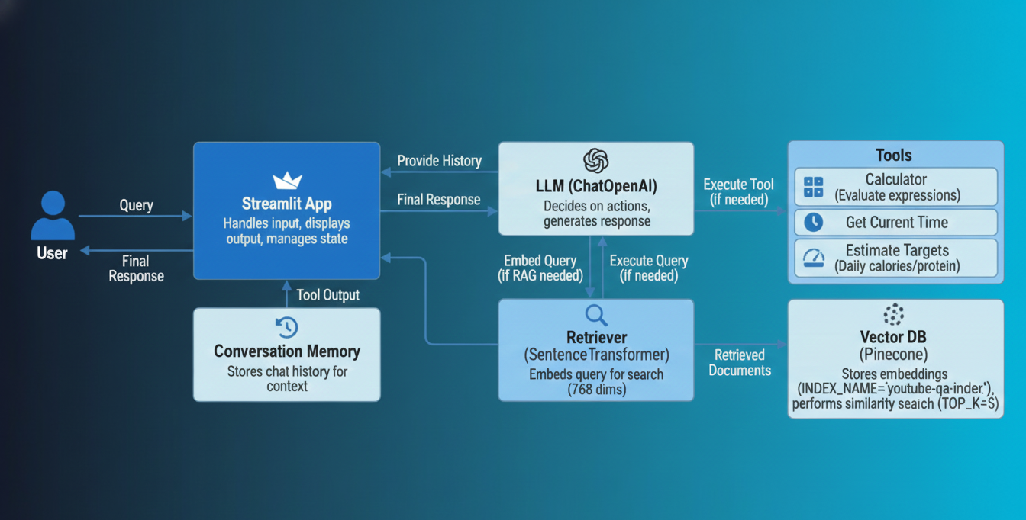
Technical Summary v1
Notes:
This is the V1 BodyLogic RAG Agent with Tools and Conversational Memory query flow.
When a user submits a query, it's first enriched by Conversational Memory for context. The query then goes to an LLM (OpenAI's GPT), which decides if it needs to:
Retrieve Information (RAG): If knowledge base retrieval is needed, the query is embedded by a SentenceTransformer and used to fetch relevant documents from the Pinecone Vector Database (ensuring matching 768-dimension embeddings).
Use Tools: If the query requires specific actions like the estimator tool, the LLM calls one of the available tools.
The LLM then synthesizes information from the retrieved documents and tool outputs, and combines it with conversation history to provide a final, informed response back to the user through the Streamlit application.
Limitations The V1 code uses a custom LangChain Expression Language (LCEL) chain (i.e., a series of RunnableLambda functions piped together). This approach does not automatically recognize or integrate a standalone LangChain Memory, V1 uses the custom LCEL (LangChain Expression Language) chain architecture, which requires manual tool execution. In V1, the LLM isn't doing deep "reasoning" about the user's intent to decide on a tool; it's using a built-in, highly structured feature called Function Calling (or Tool Binding).

Slide 4
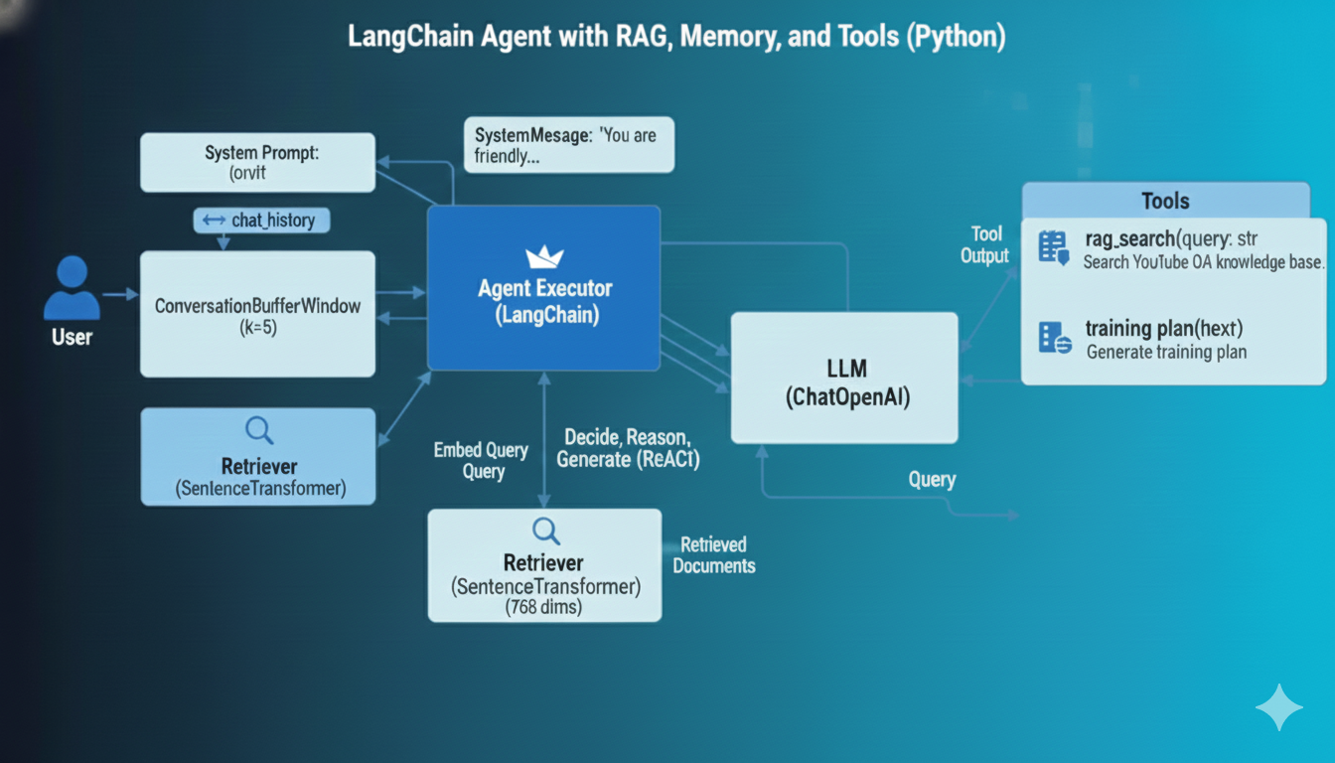
Technical Summary v2
Notes:
In V2,The Agent Executor orchestrates the entire workflow, utilizing the ZERO_SHOT_REACT_DESCRIPTION framework to allow the LLM to dynamically reason, plan, and choose external tools. It uses ReAct (Reasoning and Acting) framework, allowing the LLM to generate internal Thoughts and choose the best Action.
This agent system is also augmented with Tools—including a RAG (Retrieval-Augmented Generation) search for specialized knowledge and utility functions—to ensure responses are accurate and grounded in external data.
Memory
ConversationBufferWindowMemory maintains conversational context by storing the last five turns, enabling the agent to handle multi-step queries and provide coherent, personalized advice.
V2 successfully incorporates lanchain memory because it uses the official initialize_agent function and passes a configured ConversationBufferWindowMemory object directly to it.

Slide 5
Dataset and Processing (v1 and v2)
1. Data Selection and ingestion
The Data comes from expertly curated Youtube videos focusing on health and fitness.
The data processing uses the specialized YouTubeTranscriptApi library.
2. Processing
This broke it into overlapping chunks of about 500 characters with 50‑character overlap.
3. Vectorization
The processed data is converted into vectors and stored in the Pinecone Vector Database using the all-mpnet-base-v2 model - a good all round model for semantic search.

Slide 6
Q&A Agent v1
1. General Architecture
End-to-End Workflow:
4 -Step LangChain Runnable Chain
Core reasoning:
OpenAI's gpt-3.5-turbo
RAG Retrieval:
Uses a SentenceTransformer (all-mpnet-base-v2) to embed the user's query and retrieve context from the Vector Database
Tools:
The LLM can access and execute tools in the chain
2. Memory and Vector DB
Memory:
A global Python list stores the last 20 messages as conversation history.
Vector Database:
Pinecone
3. Prompt Template:
The System Message is the main prompt template, setting the agent's identity and providing strict instructions:
Persona: "friendly, evidence-based personal trainer and RAG assistant."
Goal: Give safe, practical fitness advice and explain reasoning clearly.
Contextual Rule: "Always use the retrieved knowledge base context when it is relevant."
Tool Use Rules: Contains explicit, mandatory rules for when to call each of the five custom tools (e.g., "you MUST call the estimate_targets tool" for macro queries).
Notes:
The Agent leverages a four-step LangChain Runnable Chain, OpenAI's gpt-3.5-turbo, a Pinecone Vector Database, and several custom tools to provide safe, practical fitness advice. The system incorporates a manual sliding window memory, a detailed prompt template, and is deployed using Streamlit with LangSmith tracing enabled for observability.

Slide 7
Q&A Agent v2
1. General Architecture
End-to-End Workflow: LangChain AgentExecutor (Initialized withAgentType.ZERO_SHOT_REACT_DESCRIPTION)
Core reasoning: Agent uses the ReAct (Reasoning and Acting) framework
RAG Retrieval: Uses a SentenceTransformer ((flax-sentence-embeddings/all_datasets_v3_mpnet-base).) to embed the user's query and retrieve context from the Vector Database
Tools:
The LLM can access and execute four explicit tools
2. Memory and Vector DB
Memory:
ConversationBufferWindowMemory with a window size of $k=5$.
This means the agent retains the last five turns of the conversation history.
AgentExecutor is responsible for automatically retrieving this history from the memory object and injecting it into the LLM's prompt as the chat_history variable for every turn. This ensures the agent maintains context.
Vector Database:
Pinecone
3. Prompt Template:
The System Message is the main prompt template, setting the agent's identity and providing strict instructions:
Persona: "friendly, evidence-based personal trainer and RAG assistant."
Goal: Give safe, practical fitness advice and explain reasoning clearly.
Contextual Rule: "Always use the retrieved knowledge base context when it is relevant."
Tool Use Rules: Contains explicit, mandatory rules for when to call each of the five custom tools (e.g., "you MUST call the estimate_targets tool" for macro queries).
Notes:
V2 AgentExecutor uses the ReAct framework to dynamically decide between various tasks.
It maintains continuous conversation Memory via ConversationBufferWindowMemory, ensuring personalized and stateful interactions. Specialized Tools—including a RAG search for external knowledge and utility functions. The ReAct (Reasoning and Acting) structure is enforced by the Zero-Shot Description agent type.

Slide 8
Tools
Database:
Pinecone
The knowledge base is built from the transcripts and content of selected YouTube videos.
The raw video content was processed (transcribed, chunked, and then converted into dense numerical vectors) using an embedding model sentence-transformers/all-mpnet-base-v2
A general-purpose model from the Hugging Face ecosystem, specifically designed for creating embeddings that capture the semantic meaning of text.
Tools:
Calorie and/or Macro Target Calculation.
The tool is engineered to estimate a user's target calorie and/or macronutrient intake.
It takes structured inputs (like age, weight, activity level) and returns a structured output (estimated calorie/macro numbers).
If a user Submits the query: "I am a 50 year old male 80kg what should be my calories targets be? “ The LLM decides to use the estimator tool and then gives back a friendly response to the user.

Slide 9
Evaluation
1. Qualitative Testing:
I used test “Demo Prompts" that serve as a basic test suite, covering RAG, tool use, and conversational memory to see if it was working as expected.
2. Traceability and Debugging:
LangSmith is used to log, visualize, and analyze every step of the LangChain RunnableSequence.
I used this to check if my tools were being called and then adjusted the system prompt when they were not.
3. Performance metrics
Performance metrics tracked in Langsmith such as the Latency and the tokens used.

Slide 10
Conclusion
BodyLogic makes expert fitness advice from videos accessible to those who prefer reading or quick answers over watching entire videos.
It enables efficient indexing and searching, and empowers you to instantly finds specific information from the expertly curated video knowledge on important health challenges many people face.
It gives safe, practical fitness advice, tailors suggestions to the user's level and goals, and clearly explains reasoning in simple language.
BL

Slide 11
Learning and Next steps
Further iterations of this could be:-
Improved memory done in v2 yay
Deploy as an API endpoint using AWS App Runner and a custom front end.
Try different types of content in the Vector DB.
A Private RAG system with the Database and the User queries in a VPC.
A more efficient data ingestion system.

Slide 12
Dem
BL

